Slide 1
Programming Fundamentals
By
Shazmeen Batool

Slide 2
while loop
Repeats a statement or group of statements while a given condition is true. It tests the condition before executing the loop body.
The while loop has two important parts:
An expression that is tested for a true or false value.
A statement or block that is repeated as long as the expression is true.

Slide 3
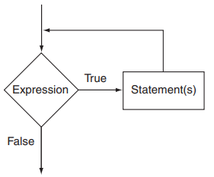
while loop

Slide 4

while loop
Here is the general format of the while loop:
In the general format, expression is any expression that can be evaluated as true or false, and statement is any valid C++ statement.
The first line shown in the format is sometimes called the loop header. It consists of the key word while followed by an expression enclosed in parentheses.

Slide 5
while loop
Here’s how the loop works: the expression is tested, and if it is true, the statement is executed. Then, the expression is tested again. If it is true, the statement is executed. This cycle repeats until the expression is false.
The statement that is repeated is known as the body of the loop. It is also considered a conditionally executed statement, because it is executed only under the condition that the expression is true.

Slide 6
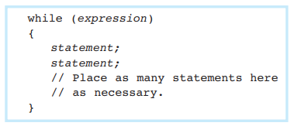
while loop
Notice there is no semicolon after the expression in parentheses. Like the if statement, the while loop is not complete without the statement that follows it.
If you wish the while loop to repeat a block of statements, its format is:

Slide 7
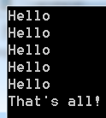
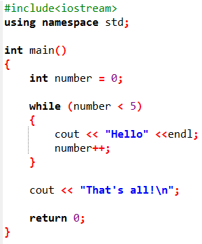
Example

Slide 8
while loop
Each repetition of a loop is known as an iteration.
This loop will perform five iterations because the variable number is initialized with the value 0, and it is incremented each time the body of the loop is executed.
When the expression number < 5 is tested and found to be false, the loop will terminate and the program will resume execution at the statement that immediately follows the loop.

Slide 9
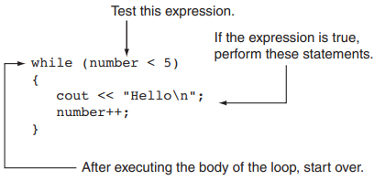
while loop
In this example, the number variable is referred to as the loop control variable because it controls the number of times that the loop iterates.

Slide 10
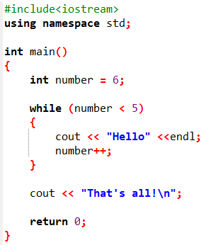

What will be the output?
The while loop is known as a pretest loop, which means it tests its expression before each iteration.
An important characteristic of the while loop is that the loop will never iterate if the test expression is false to start with.

Slide 11
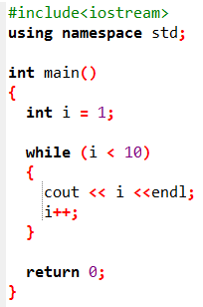

What will be the output?
Output

Slide 12
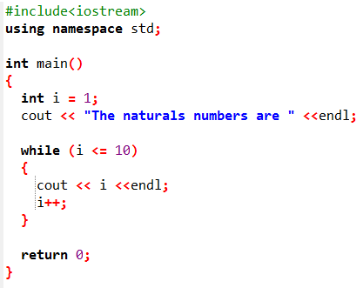
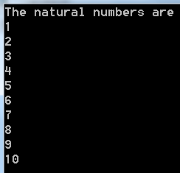
Write a C++ program to find the first 10 natural numbers using while loop.

Slide 13
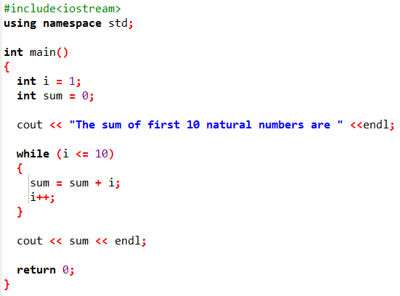

Write a C++ program to find the sum of first 10 natural numbers using while loop.
Output:

Slide 14
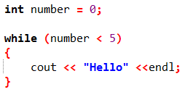
Infinite Loops
If a loop does not have a way of stopping, it is called an infinite loop. An infinite loop continues to repeat until the program is interrupted.
This is an infinite loop because it does not contain a statement that changes the value of the number variable. Each time the expression number < 5 is tested, number will contain the value 0.

Slide 15
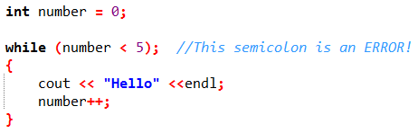
Infinite Loops
It’s also possible to create an infinite loop by accidentally placing a semicolon after the first line of the while loop.

Slide 16
Infinite Loops
The semicolon at the end of the first line is assumed to be a null statement and disconnects the while statement from the block that comes after it. To the compiler, this loop looks like:
This while loop will forever execute the null statement, which does nothing. The program will appear to have “gone into space” because there is nothing to display screen output or show activity.

Slide 17
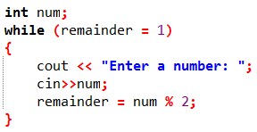
Infinite Loops
Another common pitfall with loops is accidentally using the = operator when you intend to use the == operator.
It is an infinite loop because the test expression assigns 1 to remainder each time it is evaluated instead of testing whether remainder is equal to 1.

Slide 18
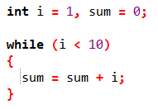
Identify the Problem

Slide 19
while Loop
As a rule the while must test a condition that will eventually become false, otherwise the loop would be executed forever, indefinitely.
Instead of incrementing, we can decrement the counter as well.
It is not necessary that a loop counter must only be an int, it can be even float.

Slide 20

Don’t Forget the Braces with a Block of Statements
If you write a loop that conditionally executes a block of statements, don’t forget to enclose all of the statements in a set of braces. If the braces are accidentally left out, the while statement conditionally executes only the very next statement.

Slide 21
Don’t Forget the Braces with a Block of Statements
In this code the number++ statement is not in the body of the loop. Because the braces are missing, the while statement only executes the statement that immediately follows it. This loop will execute infinitely because there is no code in its body that changes the number variable.

Slide 22
Programming Style and the while Loop
It’s possible to create loops that look like this:
Avoid this style of programming.

Slide 23
Using the while Loop for Input Validation
The while loop can be used to create input routines that repeat until acceptable data is entered.
Input validation is the process of inspecting data given to a program by the user and determining if it is valid.
A good program should give clear instructions about the kind of input that is acceptable and not assume the user has followed those instructions.

Slide 24
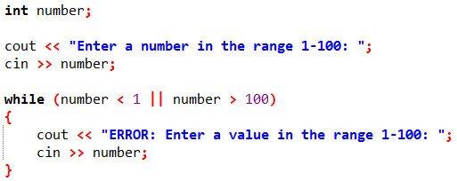
Using the while Loop for Input Validation
The while loop is especially useful for validating input. If an invalid value is entered, a loop can require that the user reenter it as many times as necessary.

Slide 25
Using the while Loop for Input Validation
The read operation that takes place just before the loop is called a priming read. It provides the first value for the loop to test. Subsequent values are obtained by the loop.

Slide 26
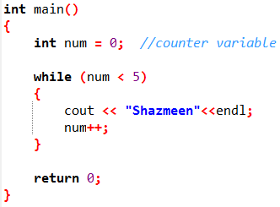
Counters
A counter is a variable that is regularly incremented or decremented each time a loop iterates.
num is used as a counter variable, which means it is regularly incremented in each iteration of the loop.
In essence, num keeps count of the number of iterations the loop has performed.

Slide 27
Controlling a Loop with a Sentinel Value
Another common technique for controlling a loop is to designate a special value when reading and processing a set of values.
This special input value, known as a sentinel value, signifies the end of the input.
A loop that uses a sentinel value to control its execution is called a sentinel-controlled loop.
When the user enters the sentinel, the loop terminates.

Slide 28
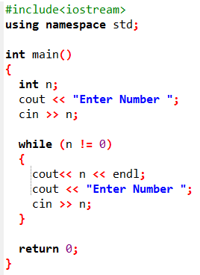
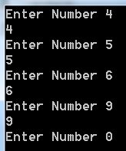
Controlling a Loop with a Sentinel Value

Slide 29
Controlling a Loop with a Sentinel Value
Example:
Create a program for a small coffee shop that allows customers to enter the number of cups of coffee they want to order. The program should continue to accept orders until the user enters a sentinel value of 0, which indicates that they are done ordering. After the user finishes entering their orders, the program should display the total number of cups ordered.

Slide 30
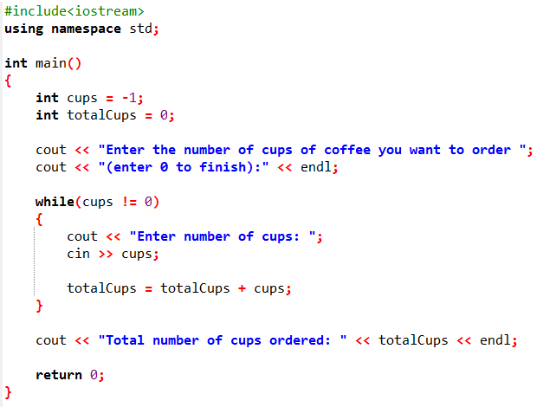
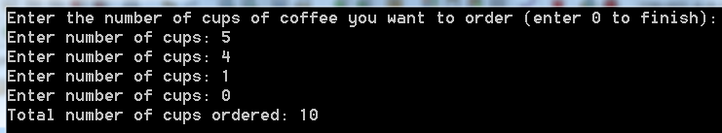
Controlling a Loop with a Sentinel Value

Slide 31
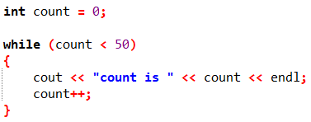

Class Activity
Convert the following while loop to a for loop:

